Slide 1
Climate Graphs

Slide 2
Learning Intention
To understand how to draw and interpret a climate graph.
Success Criteria
To draw a climate graph using temperature and rainfall data.
To interpret a climate graph.
To compare climate graphs for different areas.

Slide 3



Starter
Can you remember what climate is?
Climate is the average weather conditions of a place measured over
a long period of time. It tells you what the weather is usually like.
Can you name a place that has a different climate to the UK?
It might be somewhere you have been on holiday or seen on TV.
What was the climate like there?

Slide 4
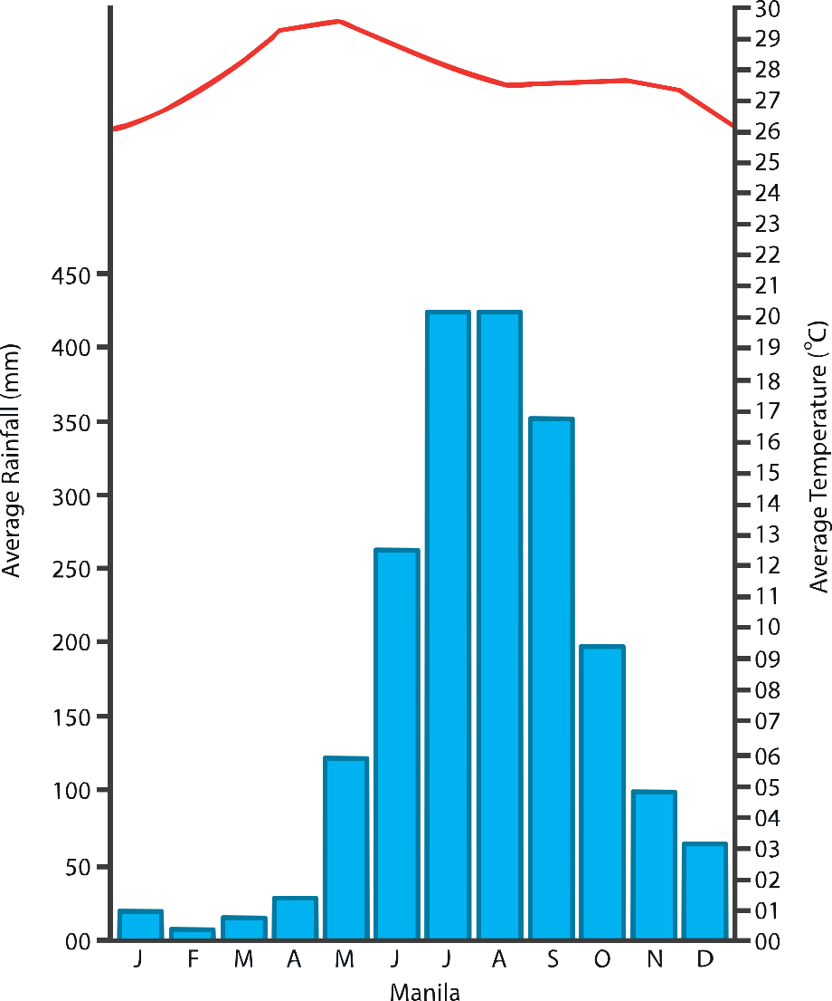
Climate Graphs
Climate graphs show the typical monthly rainfall and temperatures for a location.
peak rainfall
Temperature is shown as a line graph (red).
Rainfall is shown as a bar graph (blue).
rainfall axis
Temperature axis
months of the year

Slide 5


Climate Graphs
Why is a climate graph useful?
Who would use a climate graph?

Slide 6


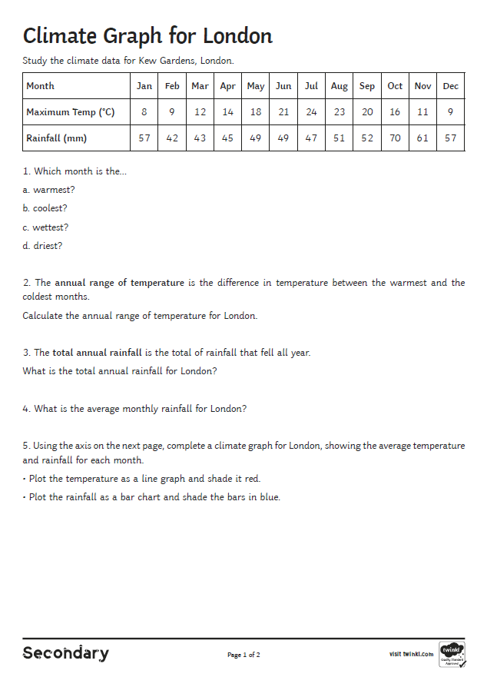
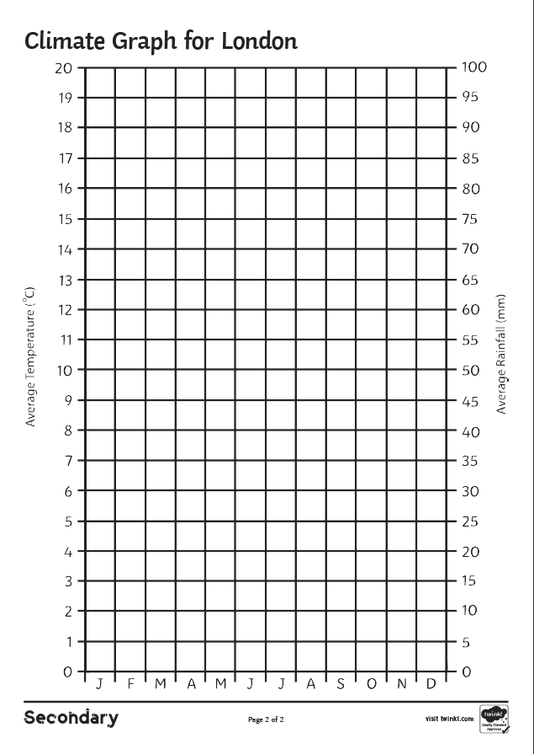
Drawing a Climate Graph
Complete the Climate Graph for London Activity Sheet.
Extension Activity
Write an accurate description of the climate of London:
Describe any patterns in temperature using key terms.
Describe any patterns in rainfall.

Slide 7
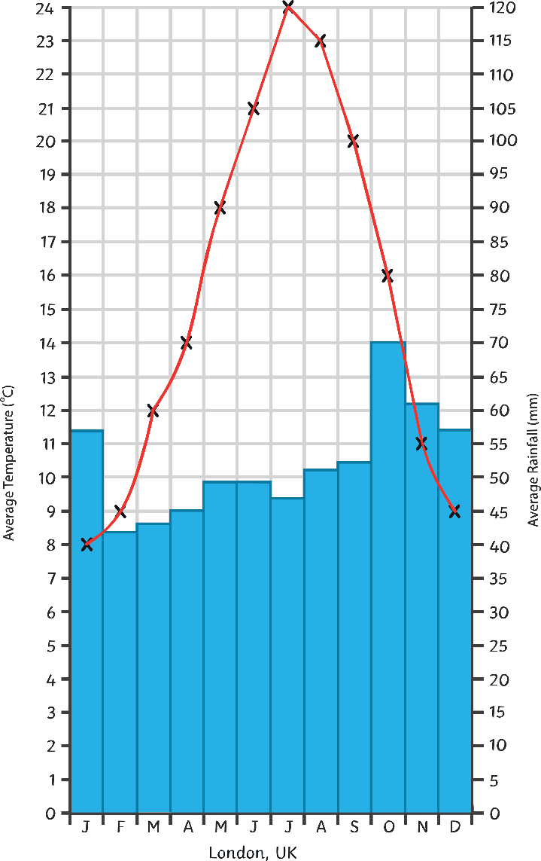
Climate Graph for London
How would you describe the climate graph for London?
Rainfall
Rainfall is fairly constant all year.
There is slightly more rainfall during the winter months.
The peak rainfall is in October.
Temperature
Temperatures are higher in the summer months.
The peak temperature is 24°C.
The annual range of temperature is quite high at 16°C.

Slide 8
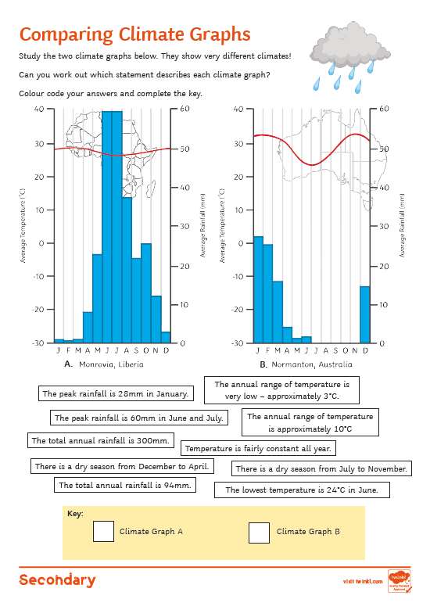

Comparing Climate Graphs
  Complete the Comparing Climate Graphs Activity Sheet to help you understand how different climates can be described.

Slide 9

Plenary – Weather Words
How many weather key words can you make from these letters?
You can use each letter more than once.
H
M
T
G
C
P
R
A
L
N
U
E
F
I

Slide 10


Did you get any of these words?
temperature
ice
climate
rain gauge
graph
rainfall
heat
gale
relief
hail

